Slide 1

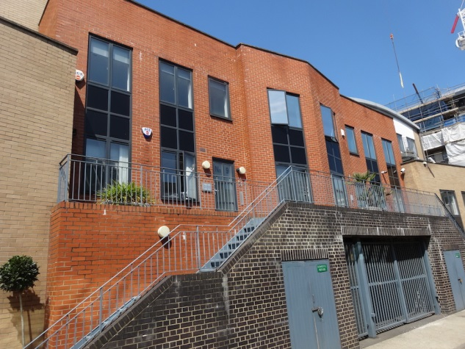
NEWLY REFURBISHED OFFICE TO LET
Tel: 07885 912 982
Insert an image here
5 RISBOROUGH STREET, LONDON, SE1
APPROX. 505 SQ FT
£25,000 PER ANNUM EXCLUSIVE

Slide 2
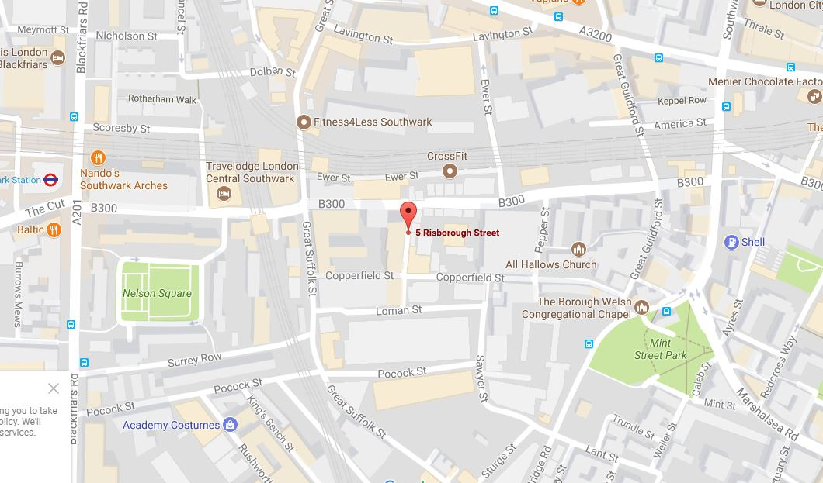
Tel: 07885 912 982
5 Risborough Street
Description
A self-contained newly refurbished office unit on the raised ground floor predominantly open plan comprising of two work areas together with a separate kitchen and two W.C facilities.
Office specifications include:
Gas central heating
Recessed spotlighting
Laminated wood flooring
Own entrance
Air-con cassettes
Double glazed windows
Office specifications include:
Service Charge
A nominal service charge to be apportioned to each of the leaseholders of the property.
MAP
EPC
EPC asset rating = 88 (Band D).
Rates
To be confirmed.
Further Details
Ian Lim
Lim Commercial
E: ian@limcommercial.com
Tel: 07885 912 982
The property is located at the northern end of Risborough Street close to the junction with Union Street and situated within equal walking distance to both Southwark station (jubilee line) and London Bridge mainline and underground station. All local amenities can be found along Great Suffolk Street with a host of restaurants and bars located along Southwark Street.
Term
A new lease available for a term up to three years on terms by arrangement.
VAT
VAT is payable on the rent and service charge
Rent
£ 25,000 per annum exclusive of all outgoings
MISREPRESENTATION ACT 1967
Important: These particulars have been prepared as agent for our clients and are intended as a convenient guide to supplement an inspection or survey. They do not constitute any part of an offer or contract and their accuracy is not guaranteed. They contain statements of opinion and in some instances we have relied on information provided by others. You should verify the particulars on your visit to the property and the particulars do not obviate the need for a full survey and all of the appropriate enquiries. Accordingly, there shall be no liability as a result of any error or omission in the particulars or any other information given.

Slide 3
Tel: 07885 912 982
MISREPRESENTATION ACT 1967
Important: These particulars have been prepared as agent for our clients and are intended as a convenient guide to supplement an inspection or survey. They do not constitute any part of an offer or contract and their accuracy is not guaranteed. They contain statements of opinion and in some instances we have relied on information provided by others. You should verify the particulars on your visit to the property and the particulars do not obviate the need for a full survey and all of the appropriate enquiries. Accordingly, there shall be no liability as a result of any error or omission in the particulars or any other information given.

